Slide 1

Rank Based Percentile Gui Calculator
Anuj Kumar Pandey

Slide 2
Approach
STEP 1:The code starts by getting the number of students and the rank of those students.
STEP 2:The code then creates two variables, students and rank.
STEP 3:The getPercentile() function will take these numbers as input and calculate their percentile according to a set formula.
STEP 4The getPercentile() function first takes the value from the total_prticipantField box.
STEP 5:This is the total number of participants in the study.
STEP 6:Next, it gets the value from the rankField box.
STEP 7:This is how many people have a particular rank in this study.
STEP 8:Finally, getPercentile() calculates each student’s percentile according to this set formula: where x is equal to the value from total_participantField, y is equal to the value from rankField, and z is equal to 100%.
STEP 9:The code calculates the percentile for a given set of values.
STEP 10:The first step is to get the number of students and rank.
STEP 11:Next, the code calculates the median and mode for these two values.
STEP 12:The getPercentile() function then takes these two values as input and stores them in a new variable called students and rank respectively.

Slide 3

STEP 13:Next, the percentile is calculated using the following equation: (students/total_participantField.get()) * 100
STEP 14:The code starts by creating a window called “GUI”.
STEP 15:The window has a green background color
STEP 16: Next, the code sets up some basic properties of the window.
STEP 17: It specifies that the title of the window is “Analyze” and that it should be displayed in a floating panel on the left side of the screen.
STEP 18: The next line of code creates an instance of Tkinter, which is Python’s built-in GUI library.
STEP 19: Next, the code sets up some basic properties for the window.
STEP 20: It specifies that it should have a border around it and that its title bar should be hidden.
STEP 21: Finally, the code assigns values to two variables: rankField and total_participantField.
STEP 22: rankField stores information about students’ ranks while total_participantField stores information about all participants in the study (i.e., both students and non-students).

Slide 4
STEP 23: Next, the code calculates student ranks using round() function and inserts them into rankField variable.
STEP 24: Then, it calculates participant counts using count() function and inserts them into total_participantField variable.
STEP 25: Finally, it uses percentile() function to calculate percentage distributions for each rank group (i.e., 1st through 10th grades).
STEP 26: The code creates a window and sets the background color to light green.
STEP 27: Next, it sets the name of the window to “Comprehend”.
STEP 28: Finally, it creates an instance of Tkinter and begins setting up its various properties.
STEP 29: The next block of code creates two text entry boxes – one for the rank field and one for the total_participant field.
STEP 30: The code then calculates the percentage of students who are lower than the student’s rank and stores this value in the percentileField text entry box.
STEP 31: The last block of code clears all of the text entry boxes by deleting their contents.

Slide 5

STEP 32: The code creates three labels: rank, andl, and total_participant.
STEP 33: The rank label has the text “Rank” and is blue.
STEP 34: The andl label has the text “And” and is blue.
STEP 35: The total_participant label has the text “Total Participants” and is blue.
STEP 36: The code sets up the GUI window with a geometry of 650×200 pixels.
STEP 37: It creates two Label objects, one for the rank label and one for the andl label.
STEP 38: The rank object has the text “Rank” as its value, while the andl object has the text “And” as its value.
STEP 39: Finally, the code creates a Total Participant object with the text “Total Participants” as its value.
STEP 40: The code creates a Rank: label, an And: label, and a Total Participants: label.
STEP 41: The Rank: label will display the rank of the data set, while the And: label will display whether all data sets have an equal number of participants or not.
STEP 42: The Total Participants: label will display the total number of participants in each data set.

Slide 6
STEP 43: The code starts with the creation of three widgets: a find percentile button, a percentile label, and a clear button.
STEP 44: The find percentile button is attached to the getPercentile function.
STEP 45: This function takes two arguments: the dataframe and the percentile rank.
STEP 46: The code creates an instance of the Button class and sets its properties accordingly.
STEP 47: The fg property specifies the foreground color, while bg specifies the background color.
STEP 48: The command property specifies how to execute the function when clicked.
STEP 49: The percentile label is created next and attached to the getPercentile function as well.
Like the find percentile button, it also has a command property that allows you to specify how to execute it when clicked.
STEP 50: Finally, we create a grid method that will help us place all of our widgets in table-like structure onscreen.

Slide 7
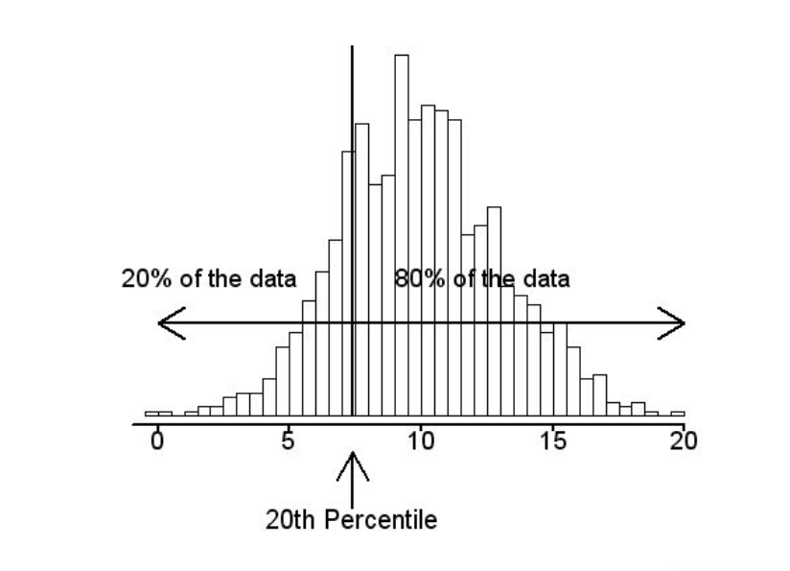
STEP 51: We use this grid method to position both buttons at 0% (the first column) and 100% (the last column).
STEP 52: We use this grid method to position both buttons at 0% (the first column) and 100% (the last column).
STEP 53: The code creates a Find Percentile button and attached to it is a getPercentile function.
STEP 54: The find widget will display the text “Find Percentile” and have a black background.
STEP 55: The percentile label will also be created and have a blue background.
STEP 56: Finally, two buttons are created, Clear and Percentile.
STEP 57: Clear will have a black background and have the command “Clear” associated with it, while Percentile will have a red background and the command “Get Percentile” associated with it.
STEP 58: The code then uses the grid method to place the widgets at respective positions in table like structure .
STEP 59: This allows for easy positioning of all of the widgets on the screen.

Slide 8
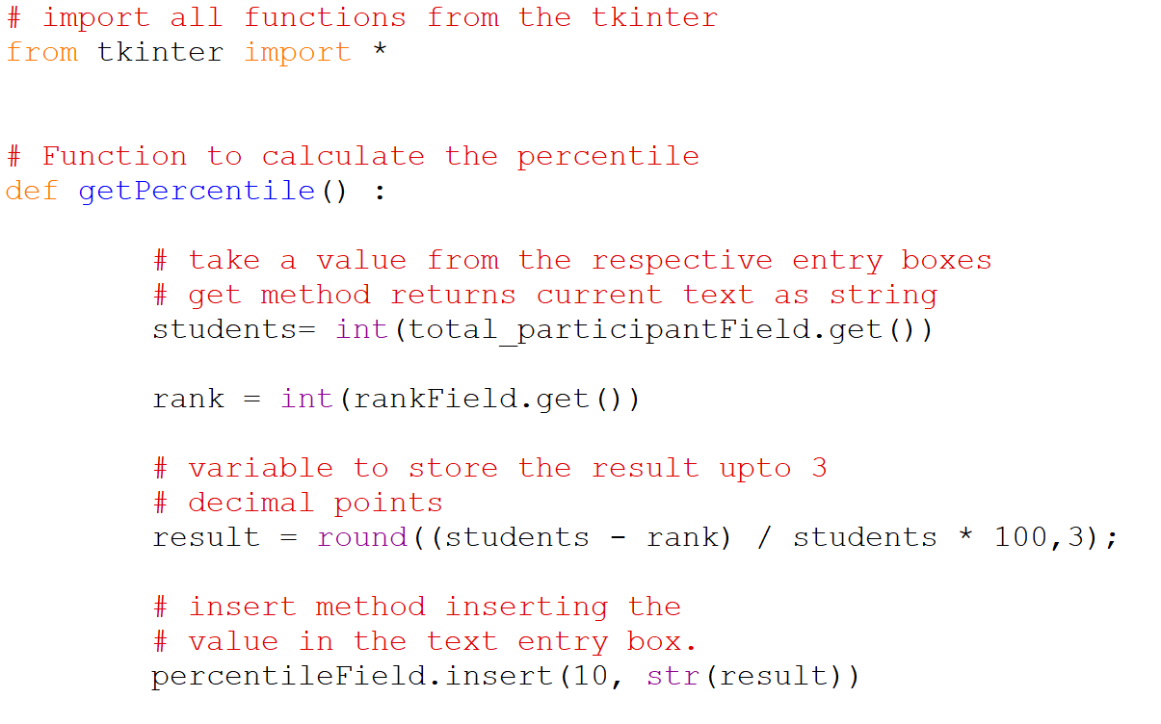
Source code explaination
Using Library Module “TINKER”

Slide 9
SOURCE
CODE
# import all functions from the tkinter
from tkinter import *
# Function to calculate the percentile
def getPercentile() :
# take a value from the respective entry boxes
# get method returns current text as string
students= int(total_participantField.get())
rank = int(rankField.get())
# variable to store the result upto 3
# decimal points
result = round((students - rank) / students 100,3);
# insert method inserting the
# value in the text entry box.
percentileField.insert(10, str(result))

Slide 10
# Function for clearing the
# contents of all text entry boxes
def Clear():
# deleting the content from the entry box
rankField.delete(0, END)
total_participantField.delete(0, END)
percentileField.delete(0, END)

Slide 11
if __name__ == "__main__" :
# Create a GUI window
gui = Tk()
# Set the background colour of GUI window
gui.configure(background = "light green")
# set the name of tkinter GUI window
gui.title("Rank Based- Percentile Calculator")
# Set the configuration of GUI window
gui.geometry("650x200")
# Create a Rank: label
rank = Label(gui, text = "Rank", bg = "blue")
# Create a And: label
andl = Label(gui, text = "And", bg = "blue")
# Create a Total Participants : label
total_participant = Label(gui,text = "Total Participants",bg = "blue")
#DRIVE
CODE

Slide 12
# Create a Find Percentile Button and
# attached to getPercentile function
find = Button(gui, text = "Find Percentile", fg = "Black",
bg = "Red",command = getPercentile)
# Create a Percentile : label
percentile = Label(gui, text = "Percentile", bg = "blue")
# Create a Clear Button and attached
# to Clear function
clear = Button(gui, text = "Clear",fg = "Black", bg = "Red",
command = Clear)
# grid method is used for placing
# the widgets at respective positions
# in table like structure .
# padx attributed provide x-axis margin
# from the root window to the widget.
rank.grid(row = 1, column = 1,padx = 10)
andl.grid(row = 1, column = 4)
total_participant.grid(row = 1, column = 6, padx = 10)

Slide 13

# pady attributed provide y-axis
# margin from the widget.
find.grid(row = 3, column = 4,pady = 10)
percentile.grid(row = 4, column = 3,padx = 10)
clear.grid(row = 5, column = 4,pady = 10)
# Create a text entry box for filling or
# typing the information.
rankField = Entry(gui)
total_participantField = Entry(gui)
percentileField = Entry(gui)
# grid method is used for placing
# the widgets at respective positions
# in table like structure .
rankField.grid(row = 1, column = 2)
total_participantField.grid(row = 1, column = 7)
percentileField.grid(row = 4, column = 4)
# Start the GUI
gui.mainloop()

Slide 14
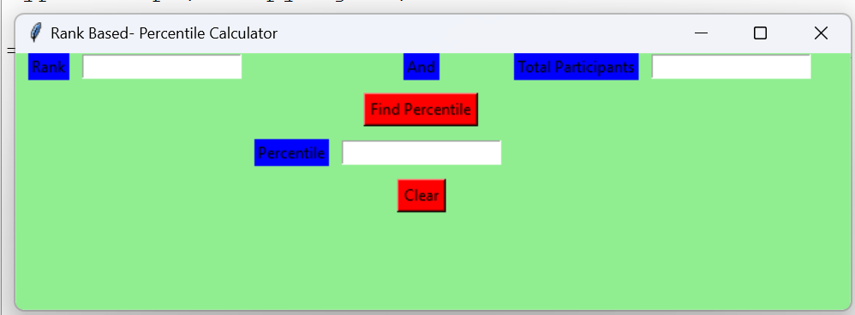
OUTPUT

Slide 15
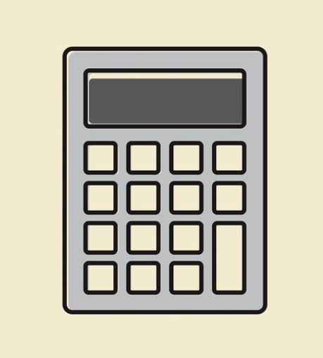
Thank You!!

